Slide 1
Disaster Situational Awareness: New Lights Technology
By: Victor Belei, Nathan Lee, and Jorge Ramos

Slide 2


Defining the Problem

Slide 3
Deliverables
Open source code that allows for a search of big data
Flexible code that allows the user to change keywords
Disaster specific webpage with relevant articles
The search pulls the title, abstract, url, and photo of the article

Slide 4



Data Scraping

Slide 5

Data Scraping

Slide 6

Data Collection

Slide 7


Data Collection

Slide 8


Data Collection
428 Sources
10,000 Articles

Slide 9



Model Selection
Sort by Relevance Train/Test
Content Based Recommender
Search Engine with Word2Vec

Slide 10
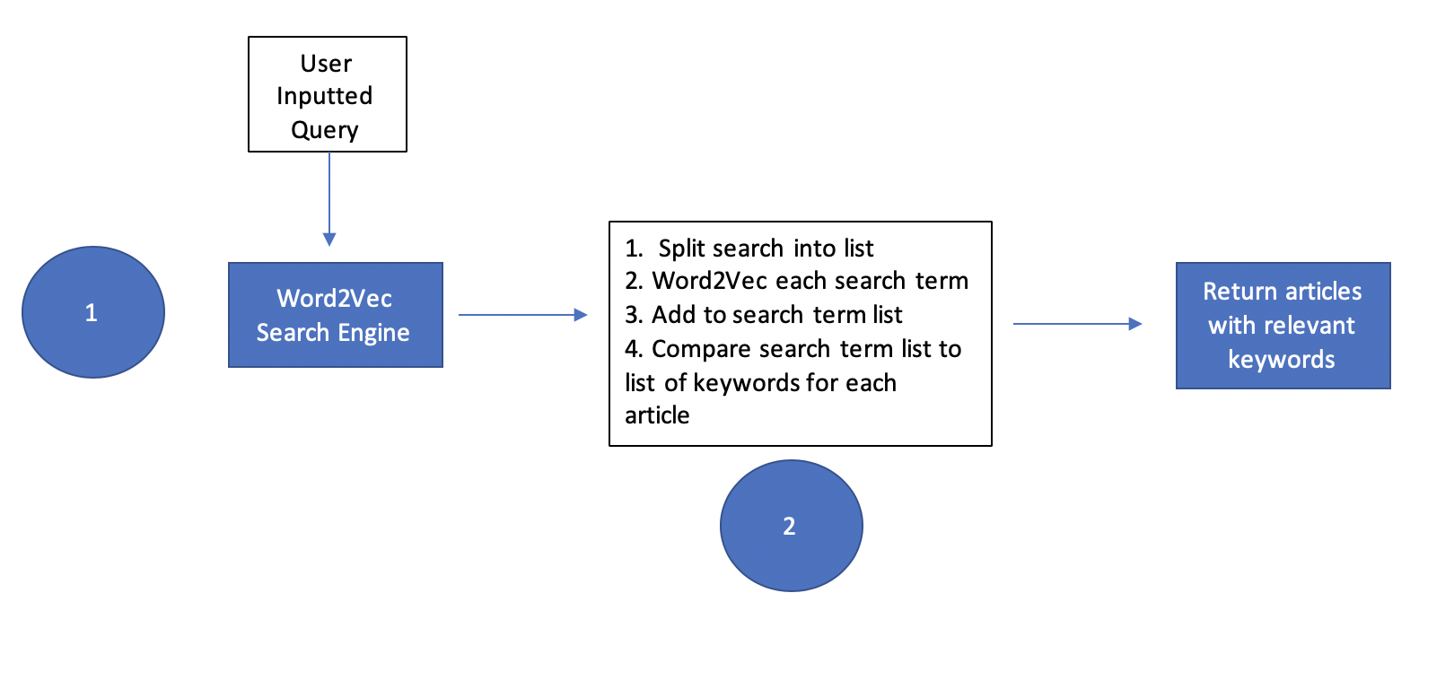
The Search Engine
“California Wildfire”

Slide 11


The Recommender system

Slide 12
Content based Recommender
Original ARTICLes from the NEWS SITES
tfIDF vectors for each document
D
d0
d1
d2
…
dK
title
content
descr
all_text
t0 | t1 | t2 | … | … | … | tN
+
+
=
tfidf(t,d,D)
pairwise similarity scores For ALL ARTICLES
SORTED similarity scores
D
d0
d1
d2
…
dK
d0 | d1 | d2 | … | dK
title
D
d46
d15
d41
d87
d12
d82
d0 | d1 | d2 | … | dK
 | 0.91
 | 0.82
 | 0.76
 | 0.75
 | 0.71
 | 0.54

Slide 13
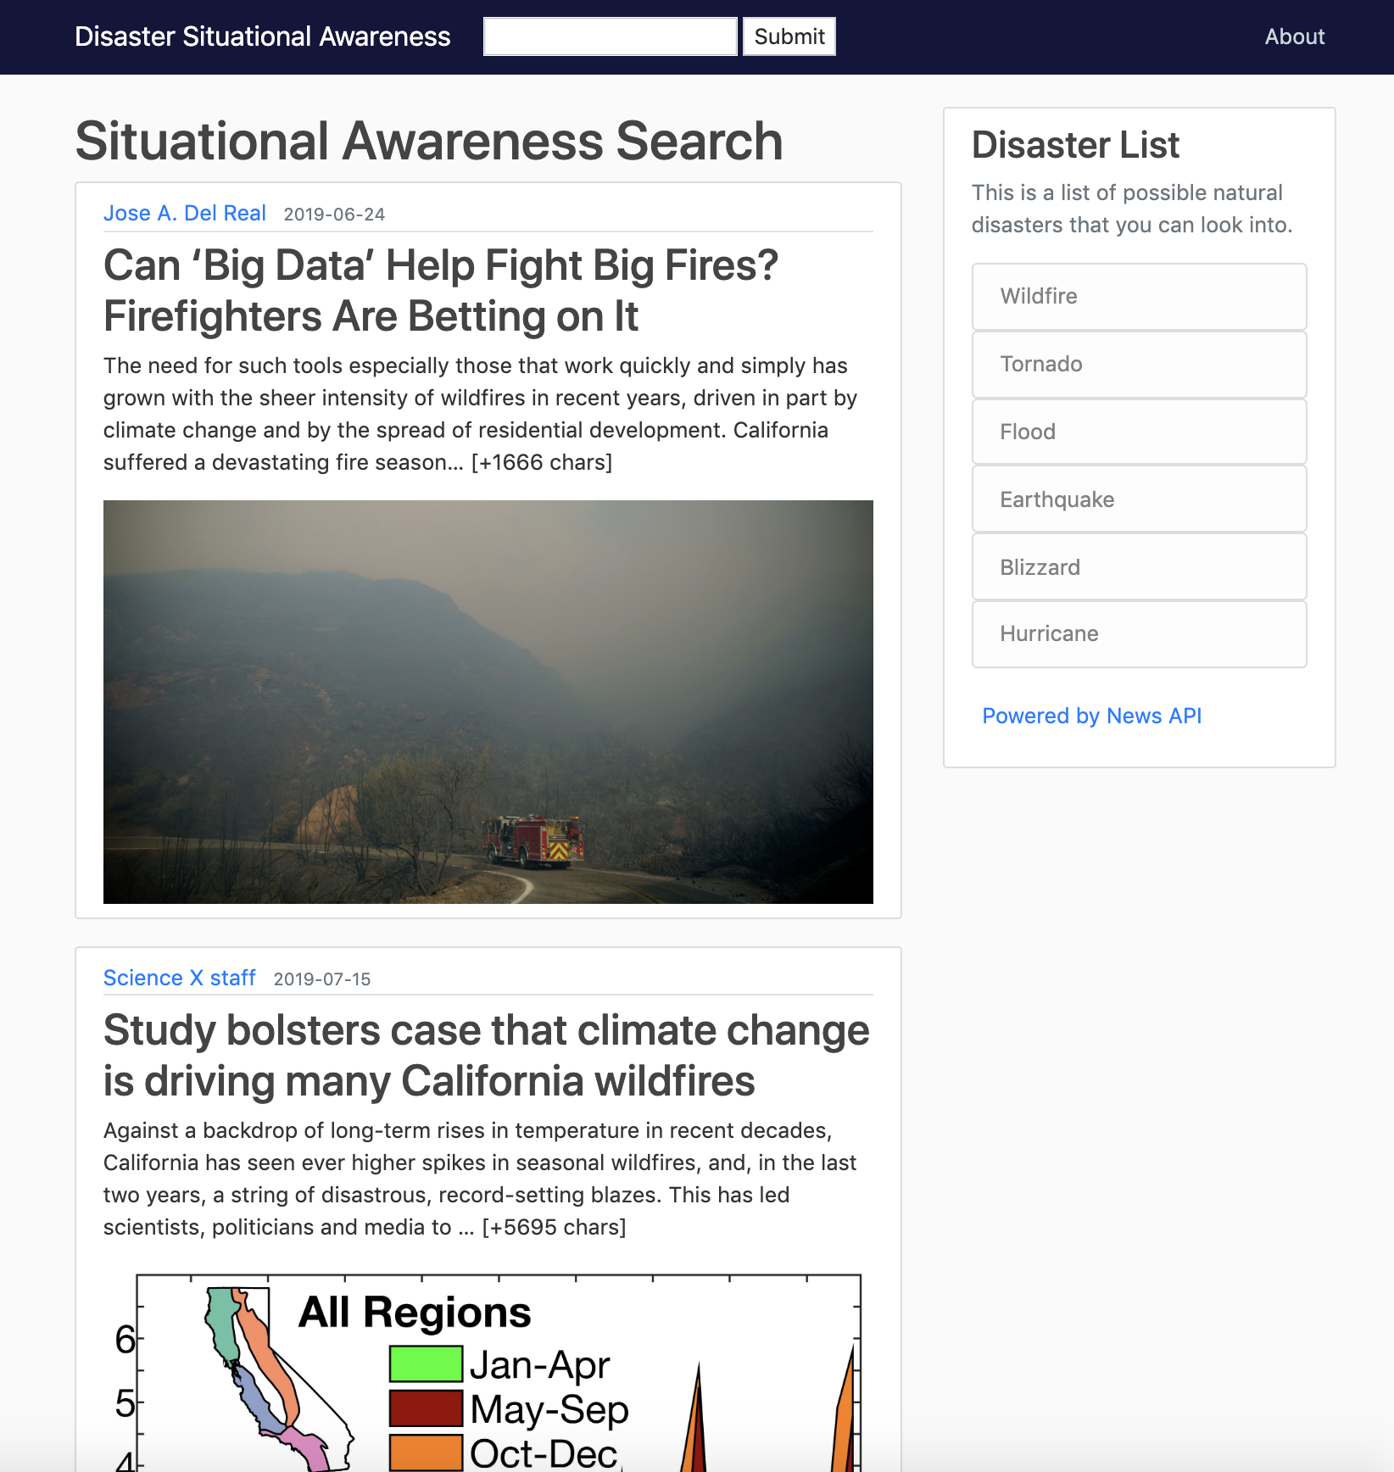
The Website

Slide 14
Next Steps
Scrape Data from Other Sources
Pair traffic data to find best evacuation routes
Real Time Scraping

Slide 15
Thank You
Questions?

